Slide 1
Quantum Computing Architectures (EE274) Lecture 17
Hiu-Yung Wong
mar. 25, 2025
hiuyung.wong@sjsu.edu, Office: ENG363
http://www.sjsu.edu/people/hiuyung.wong/index.html

Slide 2
Outline
Midterm Review
Lagrangian Mechanics and Hamiltonian Mechanics
Simple Harmonic Oscillator (SHO)
Quantization of SHO

Slide 3
Announcement
I have posted project part 1. Please check the due date and start working on it.
Midterm Review

Slide 4
Lagrangian and Hamiltonian Mechanics
Chapter 13 of “Quantum Computing Architecture and Hardware for Engineers: Step by Step”

Slide 5
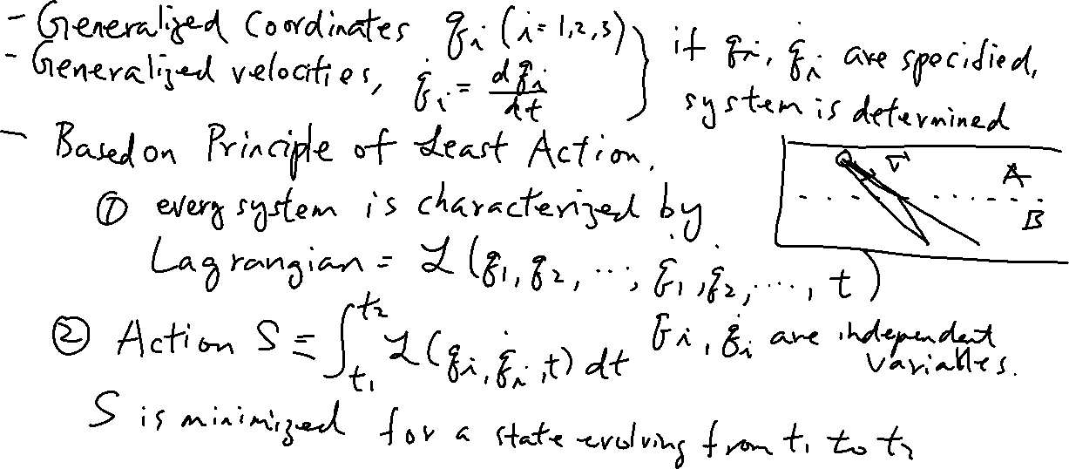
Lagrangian Mechanics
From the last lecture
Learning outcomes: Understand the concept of generalized coordinate and velocity

Slide 6
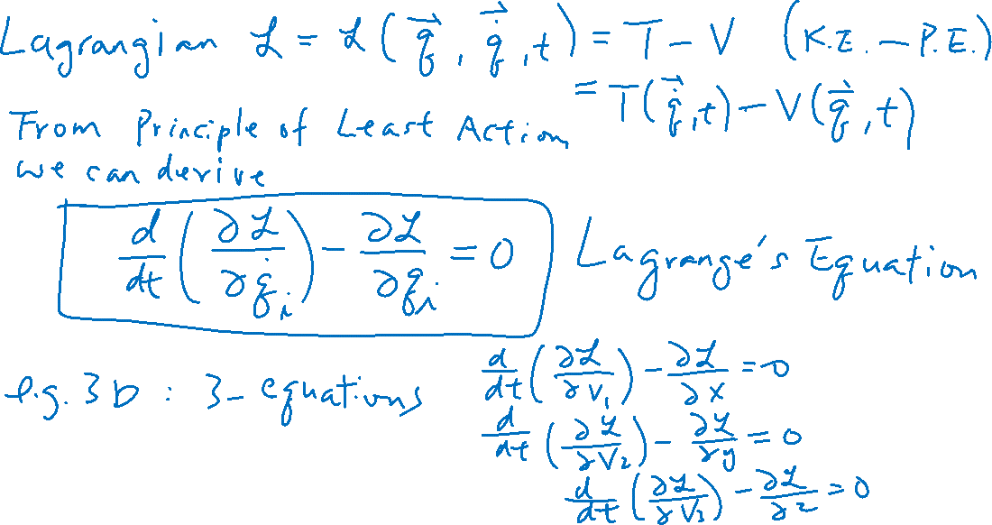
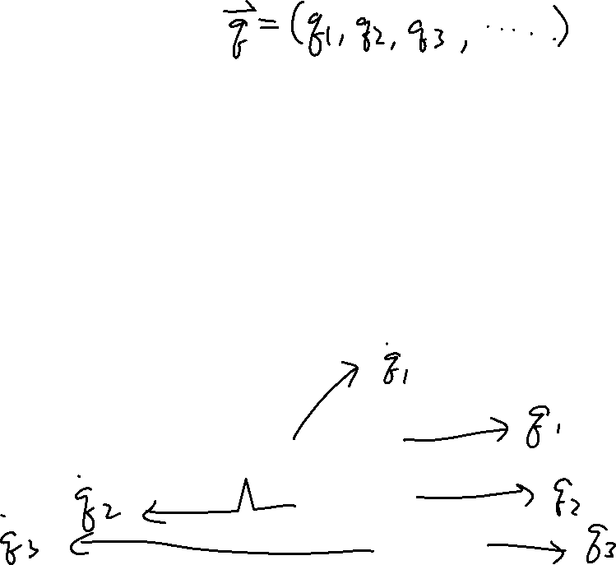
Lagrangian Mechanics
From the last lecture
Learning outcomes: Lagrange’s Equations

Slide 7
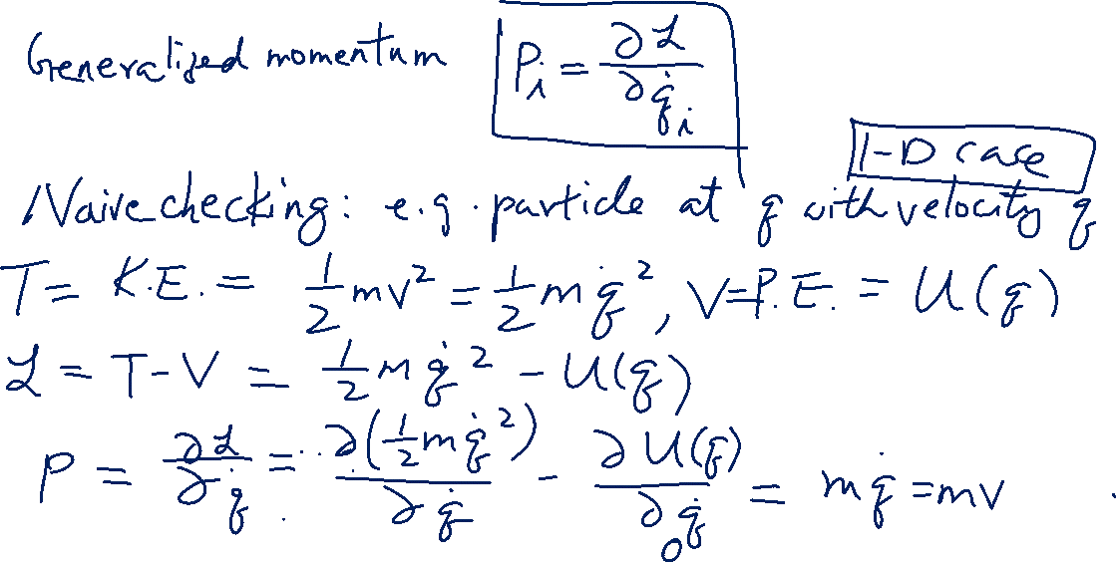
Lagrangian Mechanics
Learning outcomes: Understand the concept of generalized momentum

Slide 8
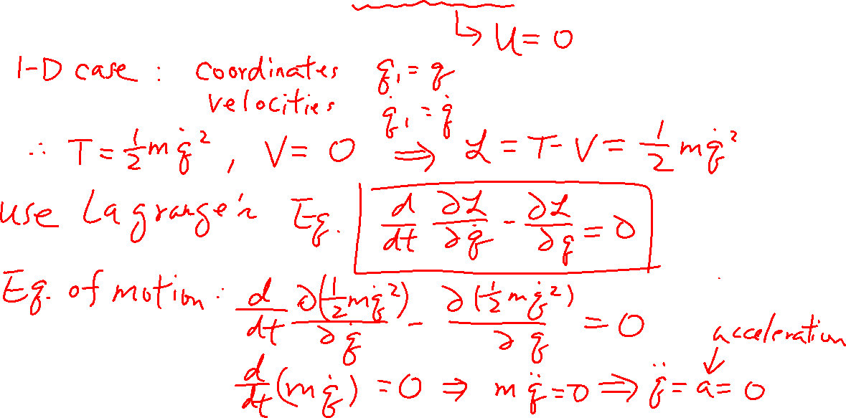
Example: Solving a Free Particle using Lagrangian Mechanics
Learning outcomes: Learn how to use Lagrange Equation

Slide 9
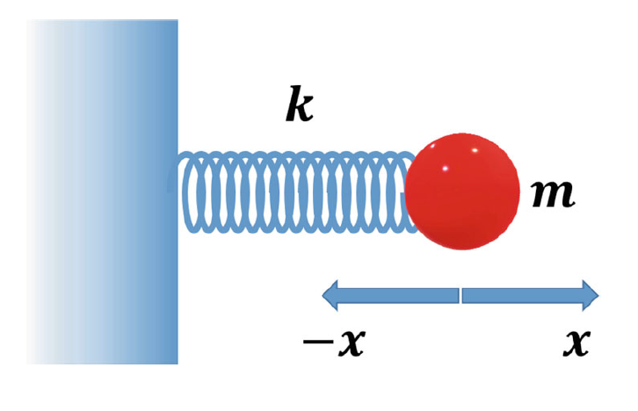
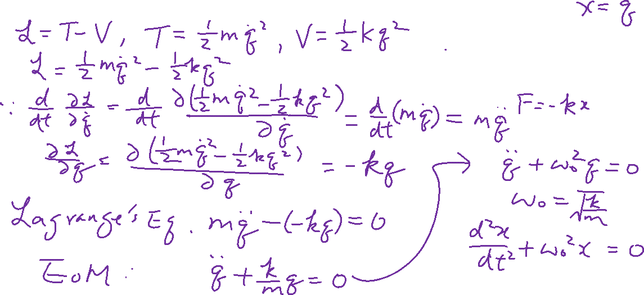
Example: Solving a Simple Harmonic Oscillator using Lagrangian Mechanic
Learning outcomes: Appreciate the power of Lagrange Mechanics

Slide 10
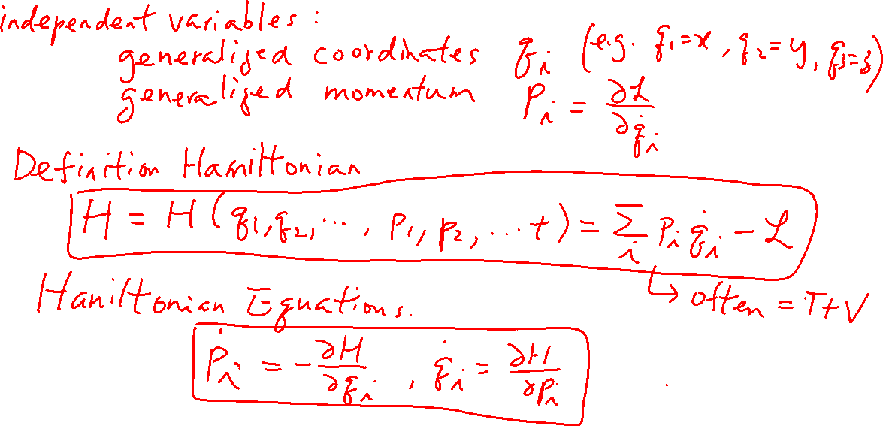
Hamiltonian Mechanics
Learning outcomes: Understand the relationship between Lagrangian and Hamiltonian

Slide 11
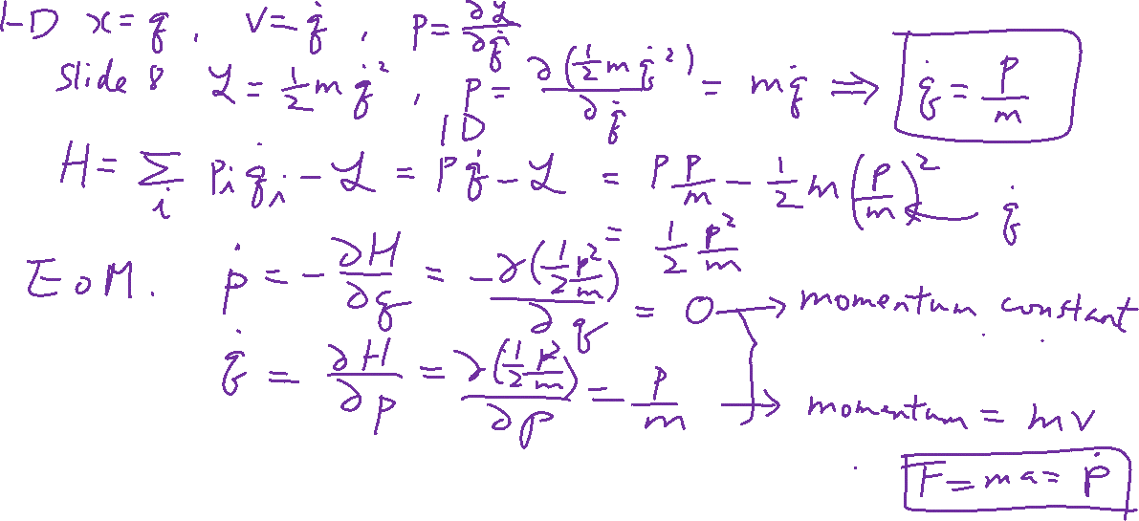
Example: Solving a Free Particle using Hamiltonian Mechanics
Learning outcomes: Learn how to use Hamiltonian Equation

